Slide 1
Virtual Networks: VPNs, VLANs and Application Level Networks
Based on slides by Ratul Mahajan at UW

Slide 2
Networks: from organizational to application level virtual networks
Famous dictum in computer science, everything can be solved with one level of virtualization (virtual memory, machines) why not networks
Very early on networking introduced new mechanisms for org level virtualization (Virtual LANs, VPNS, and VXLAN)
VLANs: virtualize a large extended LAN that is bridged
VPNs: extend the abstraction of a virtual LAN over wide area if needed
VPNs: virtual network with privacy
New trends: clouds, VMs, containers, microservices
Application level networking: Kubernetes and Istio

Slide 3
Part 1: Old school network virtualization

Slide 4
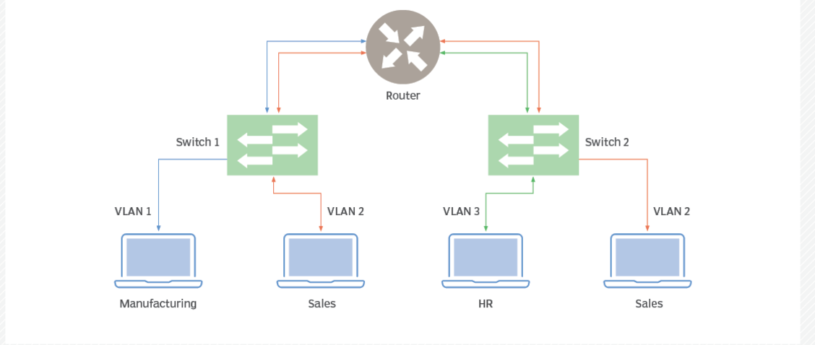
VLANS (FROM TECH TARGET)

Slide 5
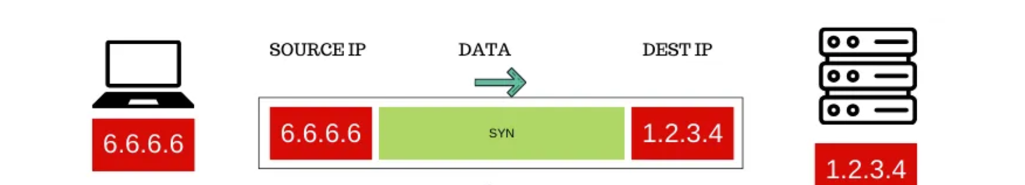
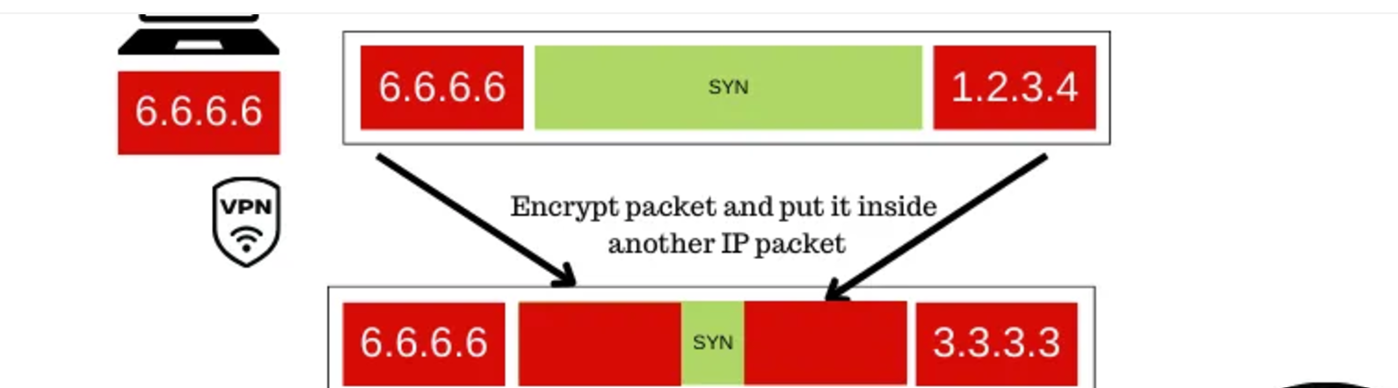
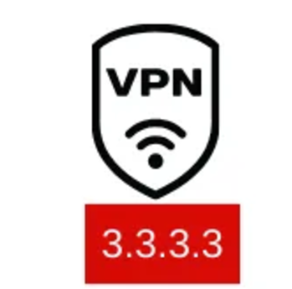
VPNs (From Hussain Nasr, Medium)
WITHOUT VPNS
WITH VPNS

Slide 6
Other Mechanisms that help
Load Balancing at DNS level, server level, and network layer via ICMP
Packet classification rules. Routers support rules on TCP/IP headers to steer traffic for security and QoS routing. Also in software with IP Tables in Linux
Software defined networks: separation of control and data

Slide 7
2: Trends (clouds, containers, microservices)

Slide 8
Trends driving this
Shift in infrastructure from own servers to cloud computing housed in data centers
Virtual Machines and then container (e.g., Docker) to cheaply share hardware CPUs as CPUs got more powerful
Software engineering change: from monolithic applications to microservices

Slide 9
And clouds

Slide 10
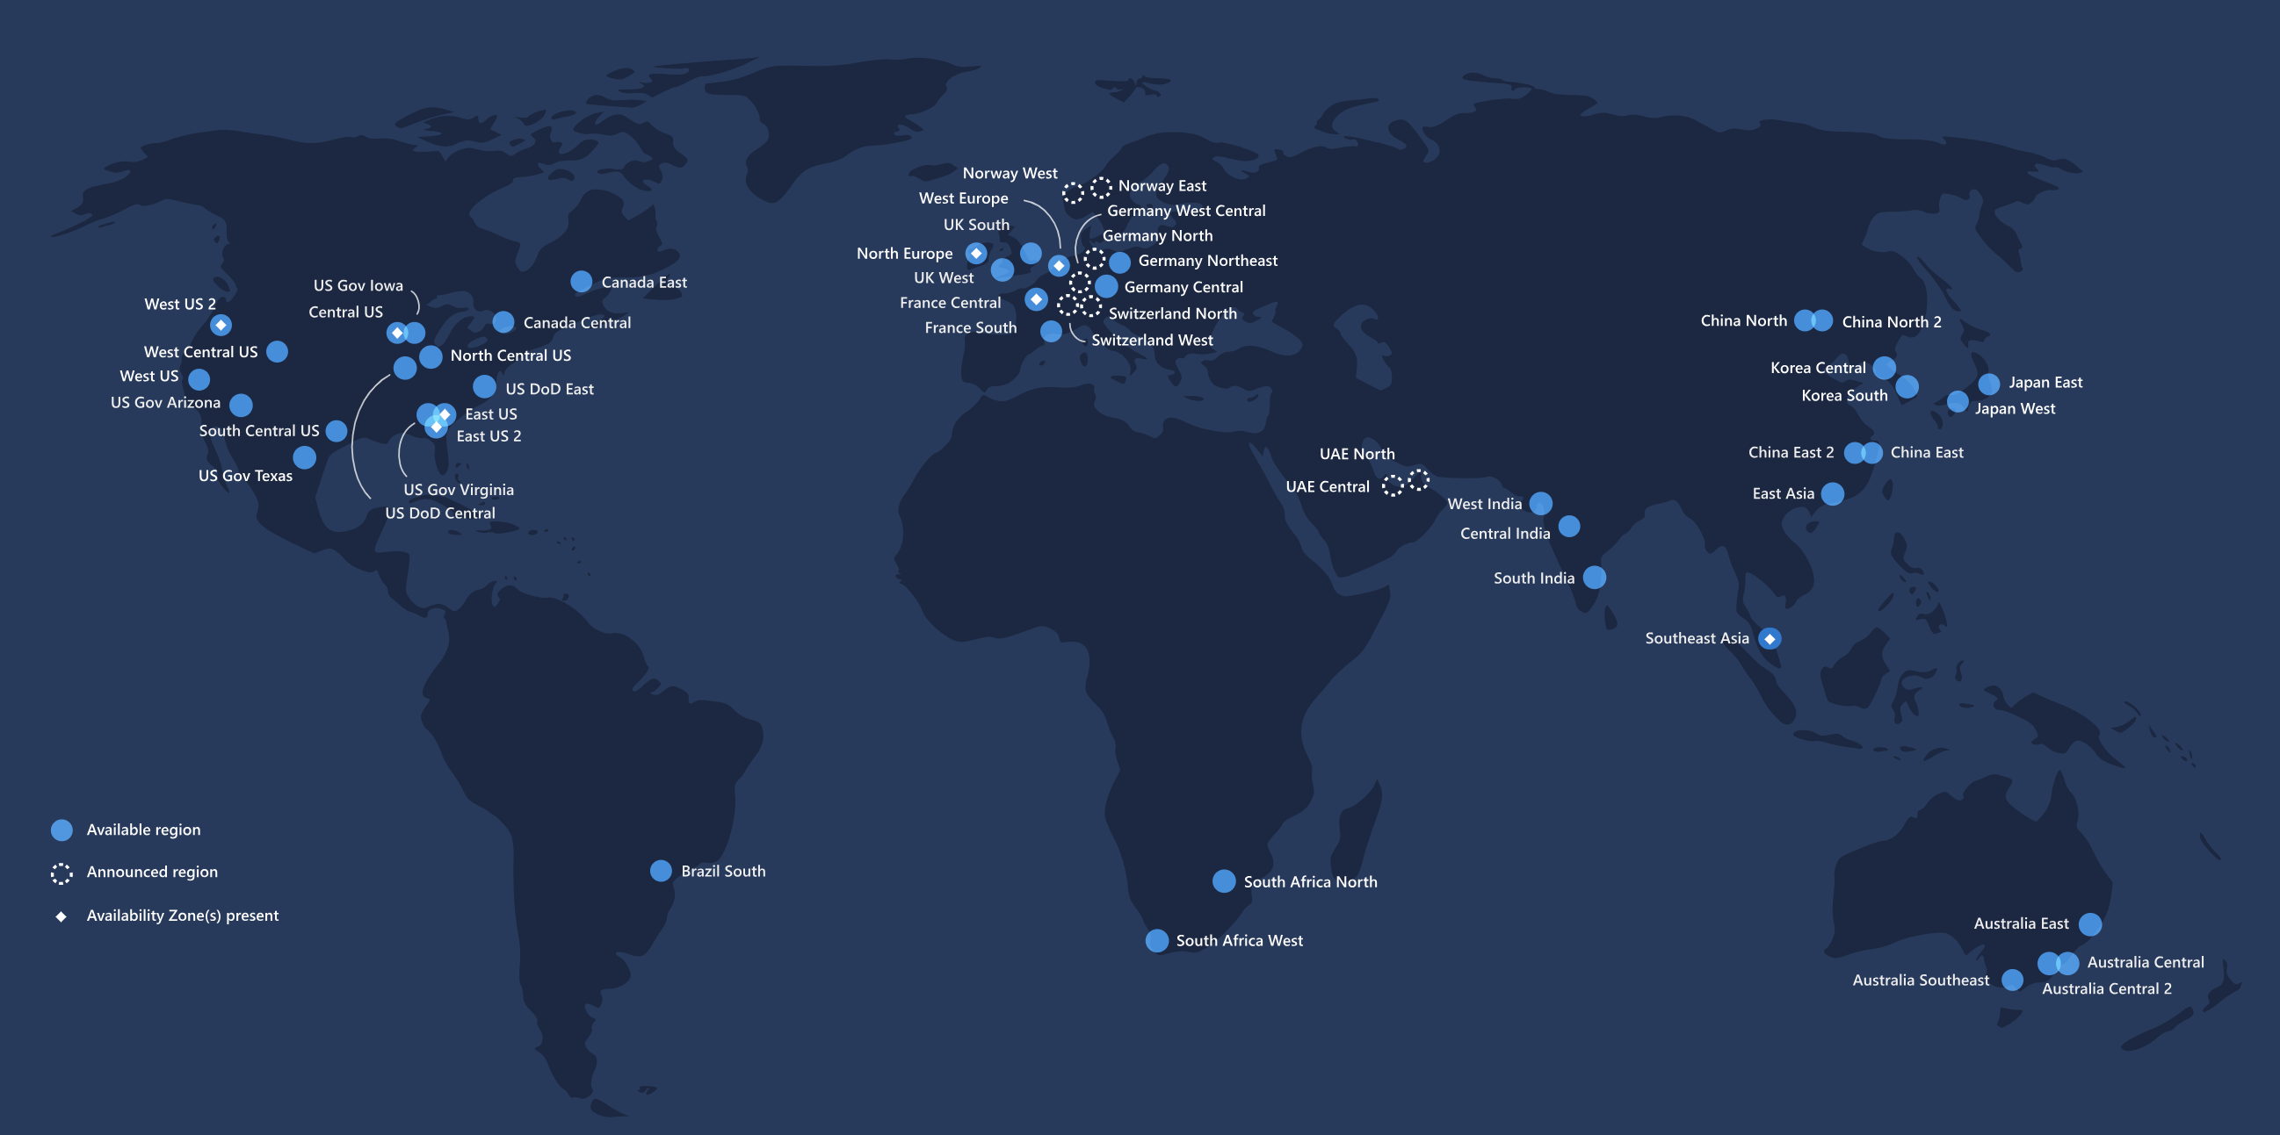
Image from Microsoft Azure

Slide 11
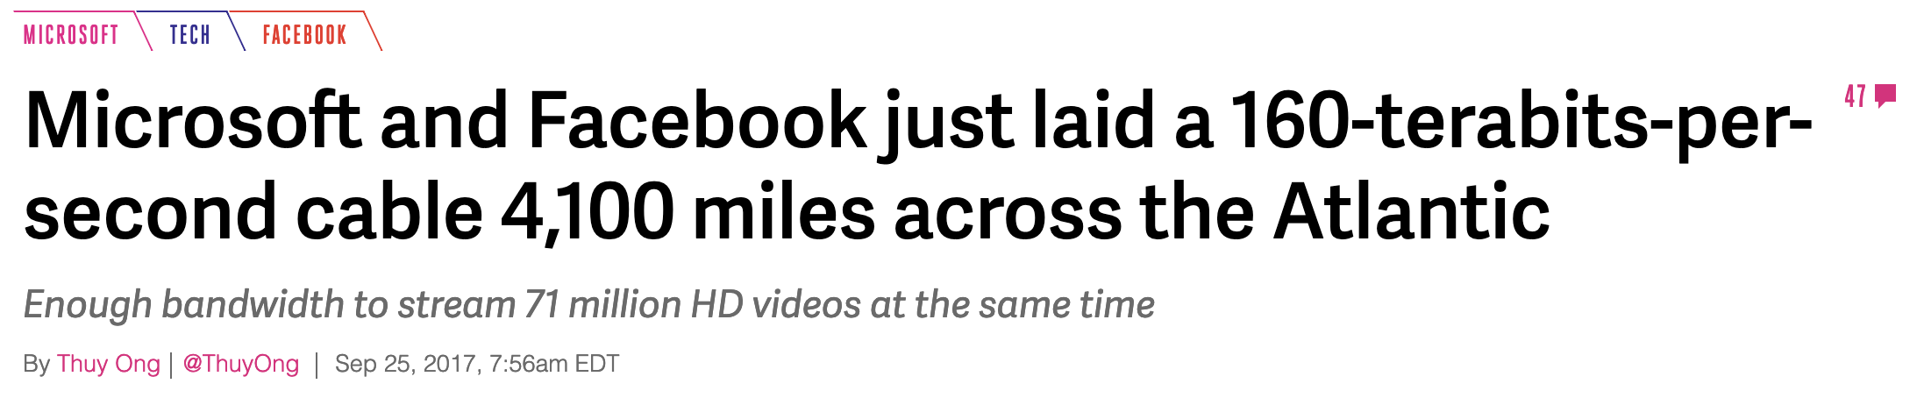
HUGE data centers (DCN)
Thousands of routers
Hundreds of thousands of servers
Connected by massive pipes
https://www.nytimes.com/interactive/2019/03/10/technology/internet-cables-oceans.html

Slide 12
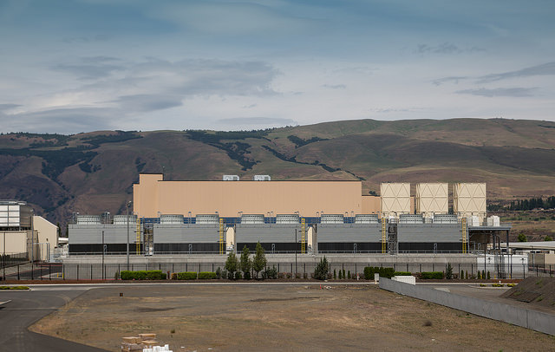
Google’s Oregon DC
Notes:
Major resources: Water, electricity

Slide 13

Inside a Google DC

Slide 14
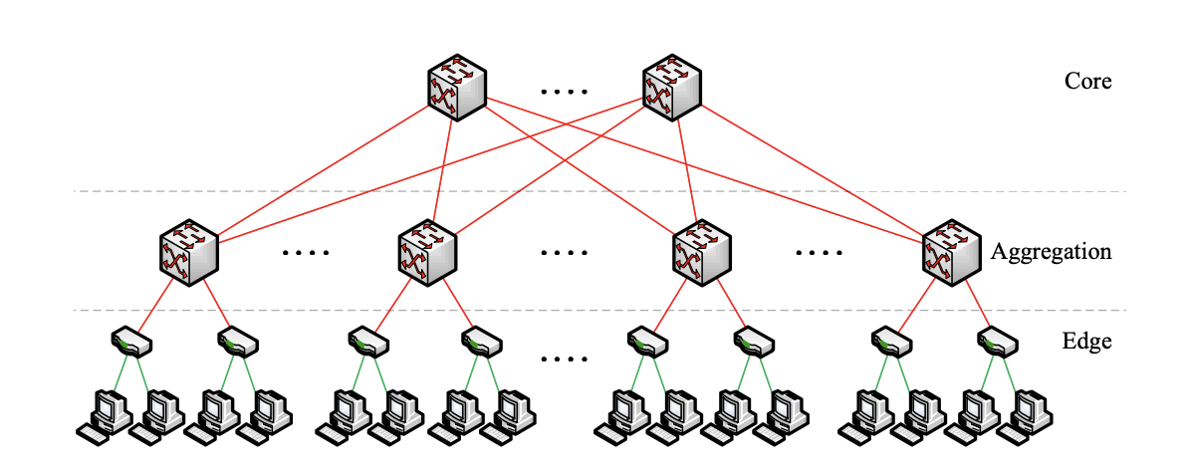
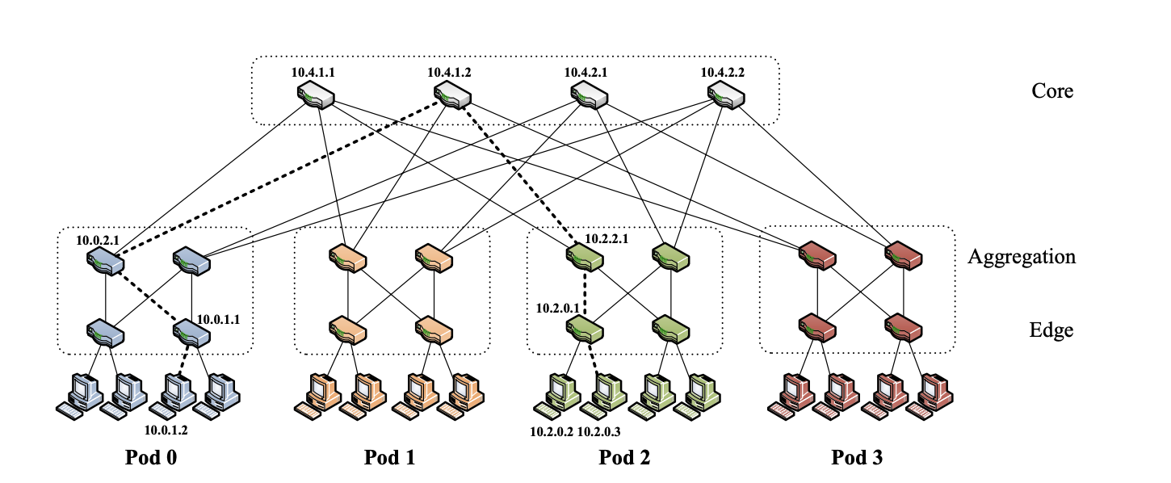
DCN topologies
Big iron → Commodity switches

Slide 15
Reality may look like either of these

Slide 16
DCN topologies
Big iron → Commodity switches
1 Gbps → 10 Gbps → 40 Gbps → 100 Gbps -> 400 Gbps (soon)
Copper → Fiber

Slide 17
Oversubscription ratio
Ratio of bisection bandwidth across layers of hierarchy
Key design parameter that trades-off cost and performance
Higher oversubscription = lower cost but higher chance of congestion

Slide 18
DCN routing
Spanning tree (L2) → OSPF/ISIS → BGP
Each router acts as its own autonomous system (AS)

Slide 19
Engineering focus
Standardization – minimize “snowflakes”
Automation and validation – minimize “fat fingering”
Performance: Low latency and efficiency
Do more in hardware (ASICs and FPGA)
RDMA

Slide 20
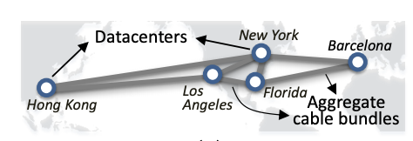
Backbone
Provides global connectivity to DCs

Slide 21
Backbone
Provides global connectivity to DCs
May also have two backbones
A “public” backbone to connect to the outside world
A ”private” backbone for inter-DC connectivity
Uses transcontinental and transoceanic fiber cables
Routing: Distributed routing → SDN-based traffic engineering

Slide 22
MPLS – Multi Protocol Label Switching
Can explicitly program paths -- tunnels
Allows taking non-shortest paths
Auto-bandwidth: Constrained-shortest paths first (CSPF)
Fully distributed computation
Estimate demand
Find shortest path(s) that can fulfill the demand

Slide 23
SDN – Software Defined Networking
Decouple control plane (routing) and data plane (forwarding)
Control plane separation opens up lots of new opportunities
Traffic engineering in backbones (next)
Network virtualization (later)

Slide 24
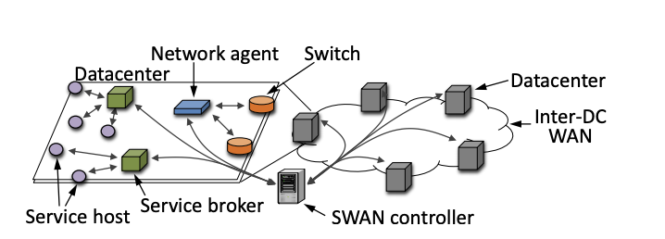
SDN-based traffic engineering
Centralized computation of forwarding tables
Compute “optimal” paths outside of the network
Based on estimated load; also factor in application priorities

Slide 25
Using the cloud
Use a software service (e.g., email) -- SaaS
Use application building blocks (e.g., database) -- PaaS
Launch VMs – IaaS
Build virtual networks
Provides the same abstraction as physical networks but with virtual devices

Slide 26
Connecting to the cloud
Public Internet
VPN from your physical resources to the cloud
BGP peering
E.g., Amazon Direct Connect

Slide 27
Using the cloud
Build virtual networks
Same abstraction as physical networks but with virtual devices
Can use your own address space
Connect via
VPN that goes over the public internet or private peering with the provider

Slide 28
The last ten years of the cloud
Scale, scale, scale … (mostly)
Relatively small conceptual shifts
Lot of automation – minimize “snowflakes” and “fat fingers”
Troubleshooting: Find needles in haystack
E.g., Everflow [SIGCOMM ‘15], CorrOpt [SIGCOMM ‘17]
Centralized control of resources
E.g., SWAN [SIGCOMM ‘13], Footprint [NSDI ‘16]
Low-latency technologies, e.g., RDMA

Slide 29
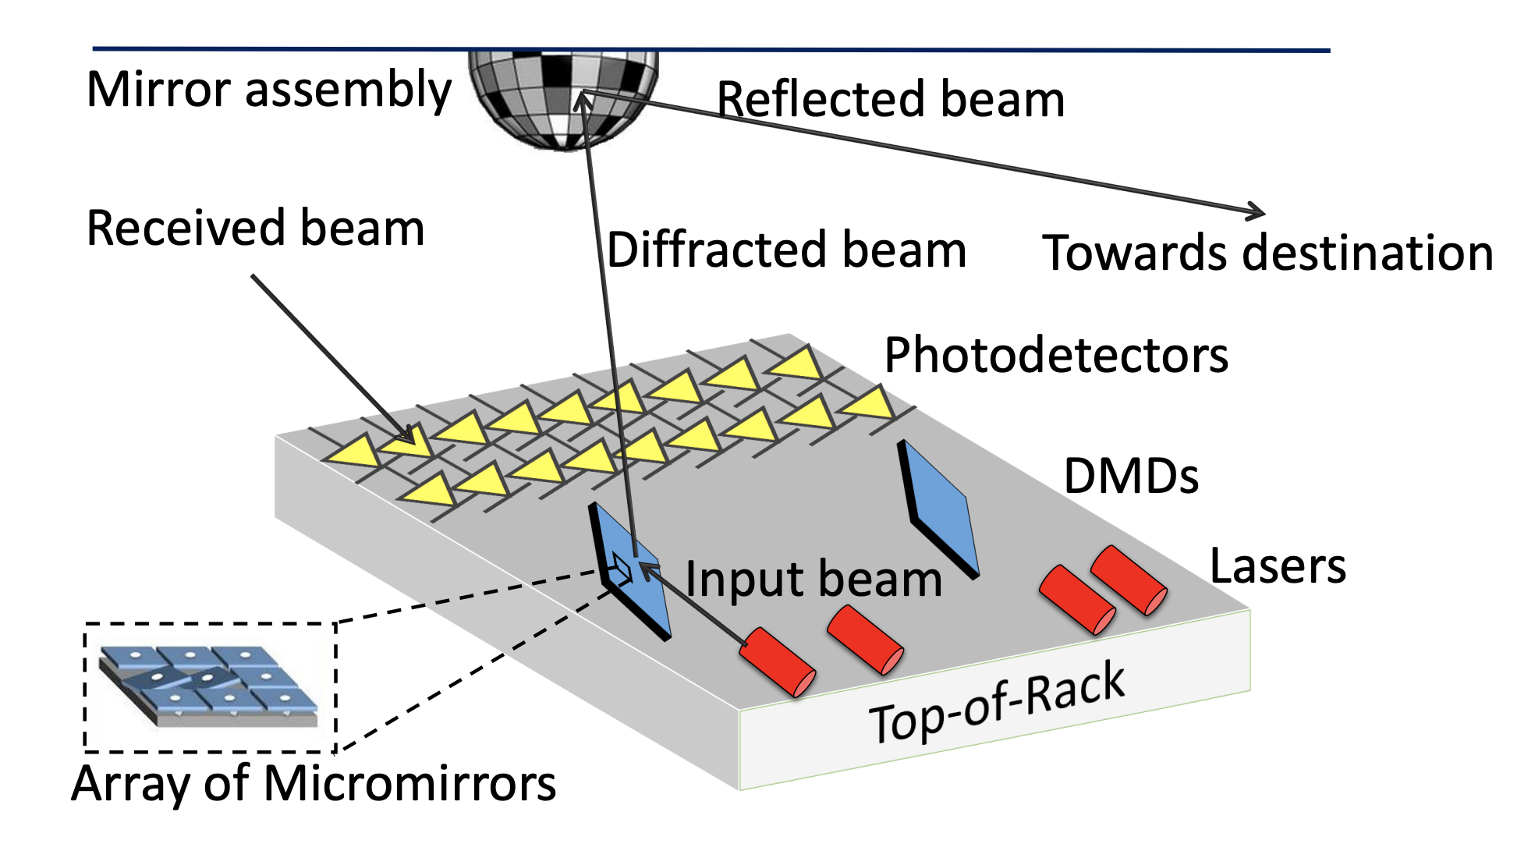
Bigger shifts are coming
Verification
E.g., Batfish [NSDI ‘15], Minesweeper [SIGCOMM ’17]
High-level synthesis
E.g., Propane [SIGCOMM ’16, PLDI ‘17]
Programmable NICs and switches
New physical layers
E.g., ProjecToR [SIGCOMM ‘16], RAIL [NSDI ‘17]
Edge computing
Tighter coupling with applications
….

Slide 30
What is in the box?

Slide 31
Router
A computer optimized for routing and forwarding
Operating system to manage resources
Routing protocol implementations (e.g., BGP, OSPF)
Lots of ports (network interfaces, not TCP ports)
Chip to forward traffic between ports at “line rate”

Slide 32
Router (2)
Traditionally, a hardware-software combo sold by a router vendor
Cisco
Juniper
Arista
….
But moving toward open systems
SONiC – open source router OS from Microsoft
Running on “commodity” hardware

Slide 33
Configuring the router
Routers are not plug-n-play
Configure IP addresses
Configure which protocols to run
Configure those protocols
Configure management aspects, e.g., DNS servers, NTP servers
Configuration uses custom syntax:
Example Cisco file: https://github.com/batfish/pybatfish/blob/master/jupyter_notebooks/networks/example/configs/as1border2.cfg

Slide 34
Configuring the router (2)
Traditionally, configuration has been done manually
Figure out the change, reason about it manually
Log in to the router and apply the change
High risk of logical errors and “fat fingers”
Increasingly, more automation
Ansible, Batfish

Slide 35
Making a network out of routers
Get them connected

Slide 36
Making a network out of routers
Get them connected
Configure routers
Basic initial configuration provides connectivity to the router
Monitor, monitor, monitor
Configuration changes and maintenance

Slide 37
What is in this box?

Slide 38
Originally
App
App
Libs
OS
Hardware
To network

Slide 39
Then came virtual machines (VMs)
App
App
App
App
HW became too powerful
Run multiple OSes on the same machine
Cheaper that way
The hypervisor virtualizes the HW and fools the OS
Provides isolation
Libs
Libs
VM
OS
OS
Virtual HW
Virtual HW
Hypervisor + OS
Hardware
To network
The network thinks multiple hosts are connected
The hypervisor acts as a hub for inter-VM traffic

Slide 40
2: Emerging Virtual Networks

Slide 41
VMs in the cloud
Customer A
Customer B
Customer B
Customer C
App
App
App
App
App
App
App
App
10.10.10.1
10.10.10.2
Libs
Libs
Libs
Libs
OS
OS
OS
OS
Overlay (virtual)
Virtual HW
Virtual HW
Virtual HW
Virtual HW
Hypervisor
Hypervisor
192.1.1.1
206.7.7.8
Hardware
Hardware
Underlay (physical)
Forwarding between VMs involves a lookup from overlay address to underlay location

Slide 42
VXLAN
VLANs are too limited to virtualizing one LAM
Also do not help with problem of VM migration which clouds to to balance load at the compute level
VXLAN provides the abstraction of a LAN across even a routed, even wide area network.
Secret: again IP in IP encapsulation (as in VPNs). Ethernet frame with a routing address of VM is encapsulated in another IP packet with a VXLAN header

Slide 43
Enter containers
App
App
Lighter-weight virtualization than VMs
Libraries, not the full OS
Better isolation and packaging than apps
Bundle the library versions you need
Container
Libs
Libs
Container runtime (Docker)
OS
Hardware
To network

Slide 44
Container networking
Connect containers to the outside world and to each other
Port conflicts among containers and other apps running on the same host
High performance between containers on the same host
(Virtual) private network between related containers (service mesh)
App
App
Libs
Libs
Container runtime (Docker)
OS
Hardware

Slide 45
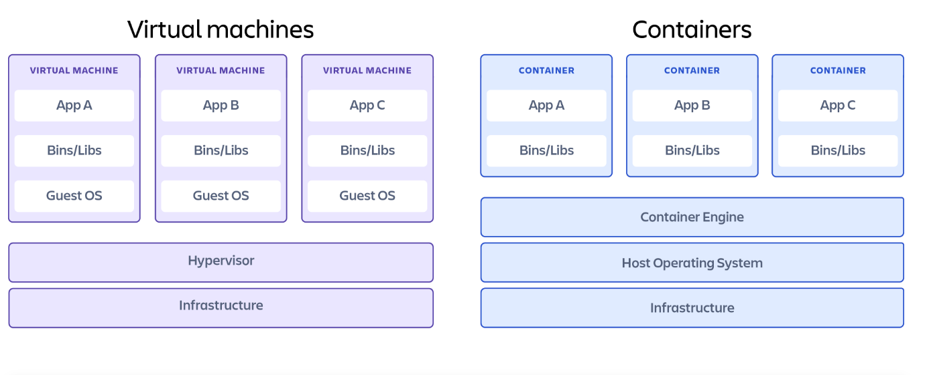
Containers versus VMs
https://www.atlassian.com/microservices/cloud-computing/containers-vs-vms
Containers are more light weight (slower iteration speed. less storage) but less robust to shared hardware exploits

Slide 46
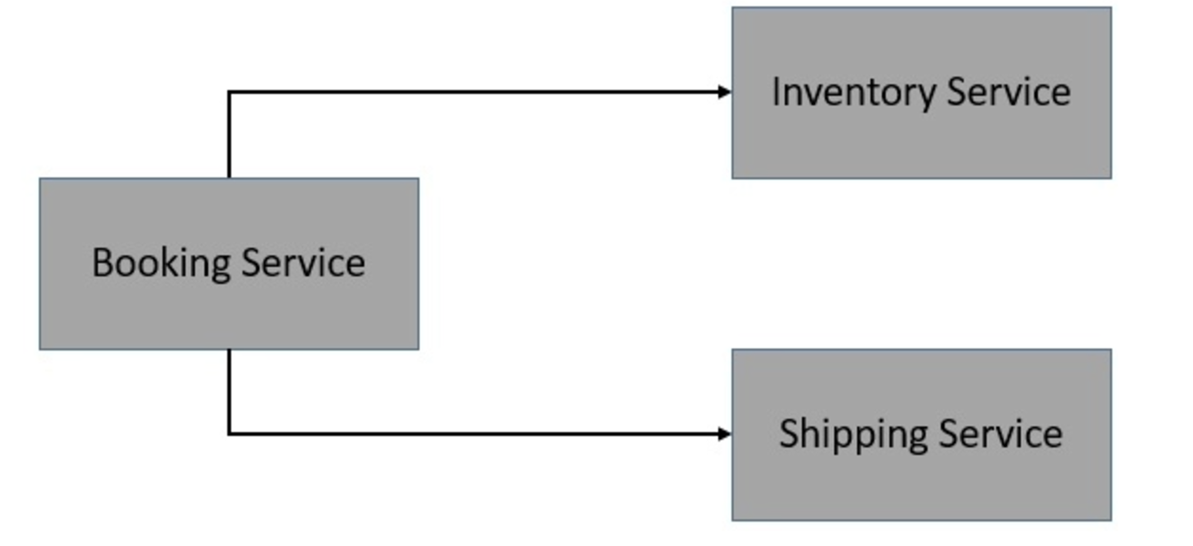
Microservice Architectures (from Baeldung)

Slide 47
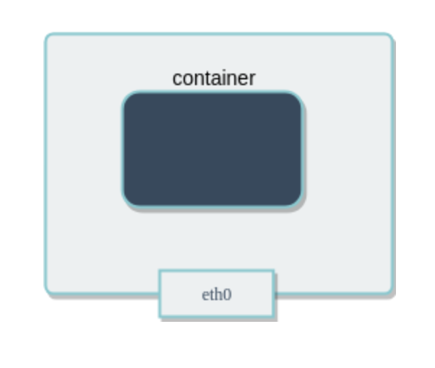
Container networking: Host
Containers share the IP address (and networking stack) of the host.
Cannot handle port conflicts
Minimal overhead

Slide 48
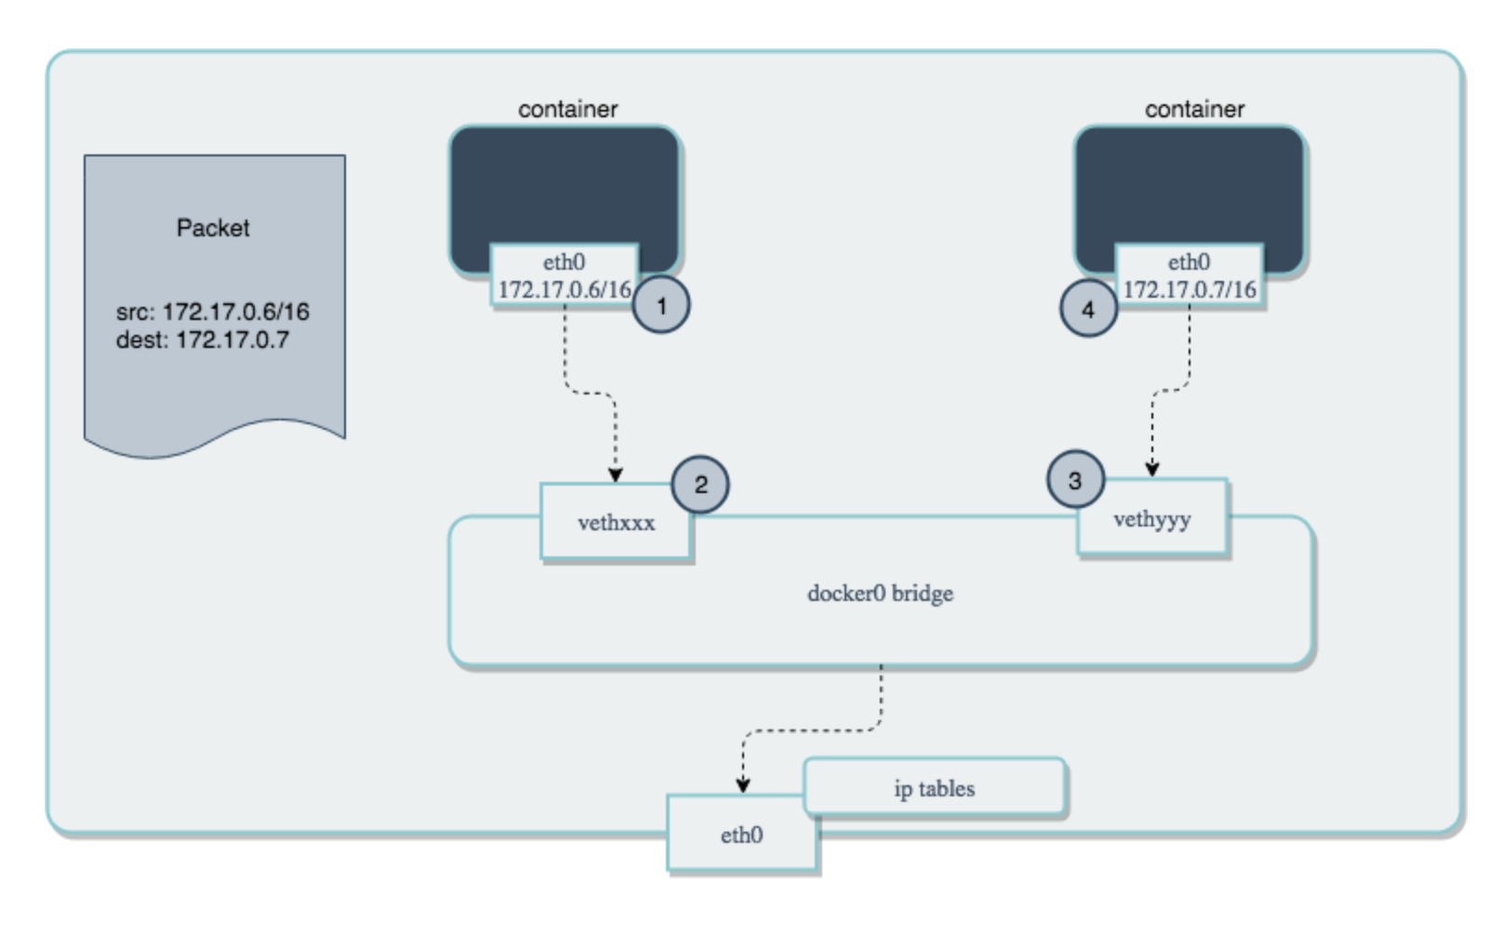
Container networking: Bridge
An internal network for containers on the same host.
Use NATs for outside world

Slide 49
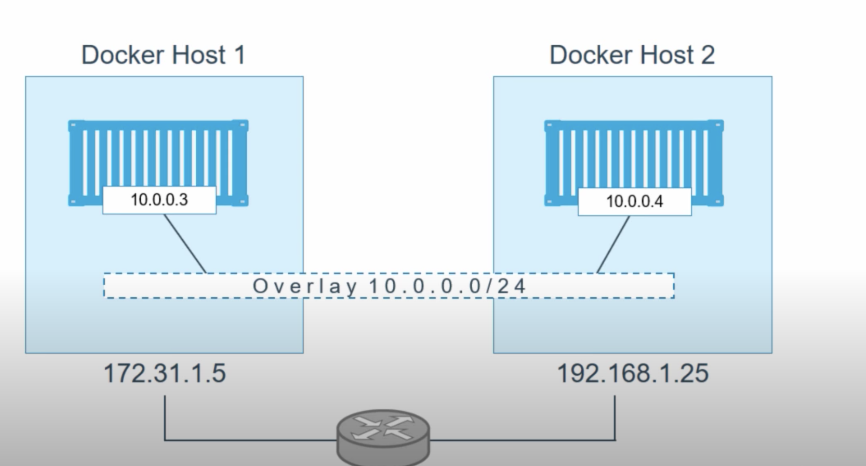
Container networking: Overlay
Create a private network across containers on different hosts
VXLAN is a common way to do that

Slide 50
CNI: Container networking interface
Specification for writing plugins to configure network interfaces
Decouple runtime from network configuration
Plugins provide an interface that orchestration engines can use
GitHub repo: https://github.com/containernetworking/cni

Slide 51
Enter microservices
Instead of a developing a large monolithic application, structure the application as a bunch of communicating microservices
Each microservice serves a (small) dedicated function, e.g., authentication
Can be written in any language
Can evolve independent of other microservices
Can be scaled independent of other microservices
Each microservice gets a container
But now you may have lots of services across lots of containers
Containers need to be deployed and scaled ➔ container orchestration
Communication between services needs to be managed ➔ service meshes

Slide 52
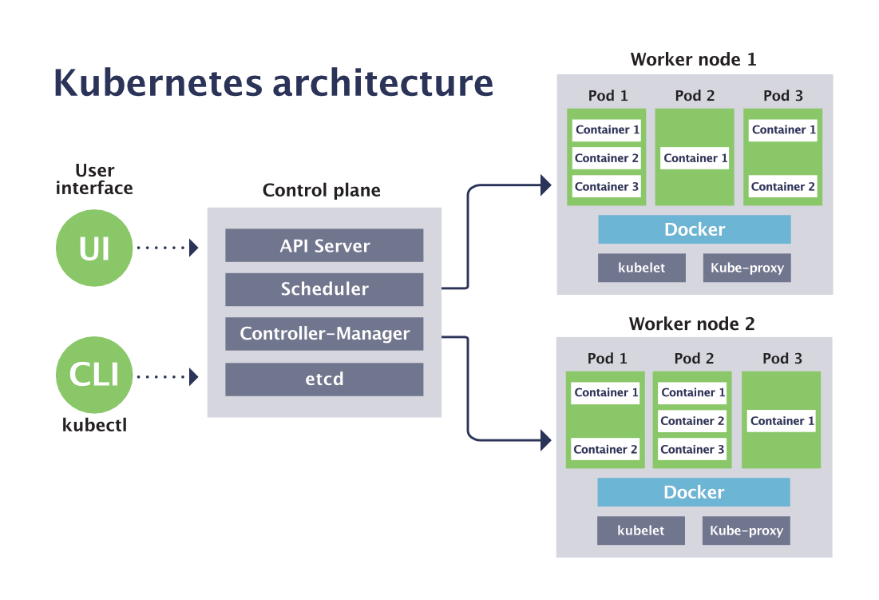
Container orchestration (Kubernetes)
Containers are wrapped in Pods which are run on a Cluster of Nodes
Pods implement a service
https://sensu.io/blog/how-kubernetes-works

Slide 53
What does Kubernetes Add?
Once we had Docker containers, it makes sense to have them be allocated to microservices
Docker saw this and had Docker swarms which are actually quite easy to configure
Kubernetes is more complex to configure but allows autoscaling (adjusting running pods or nodes to load) which is essential
Kubernetes (and Istio) take the SDN idea of separating out control and data and apply it at a higher layer (services)

Slide 54
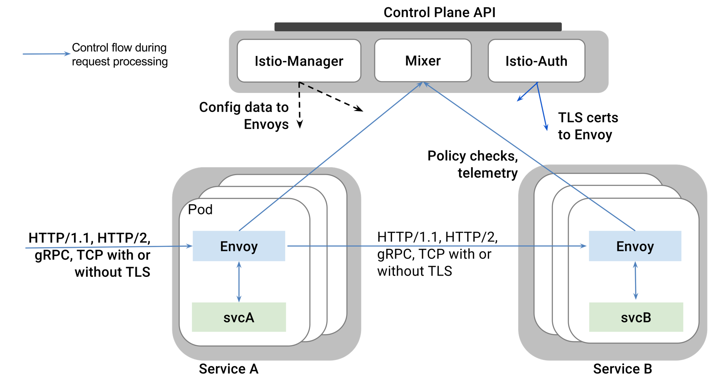
Service meshes (Istio)
“Application defined networking”
Secure inter-service communication
Load balancing for HTTP, gRPC, WebSocket, and TCP traffic
Traffic behavior (routing rules, retries, failover)
Access control, rate limits, and quotas
Metrics, logs, and traces
What is not to like?
https://istio-releases.github.io/v0.1/docs/ concepts/what-is-istio/overview.html

Slide 55
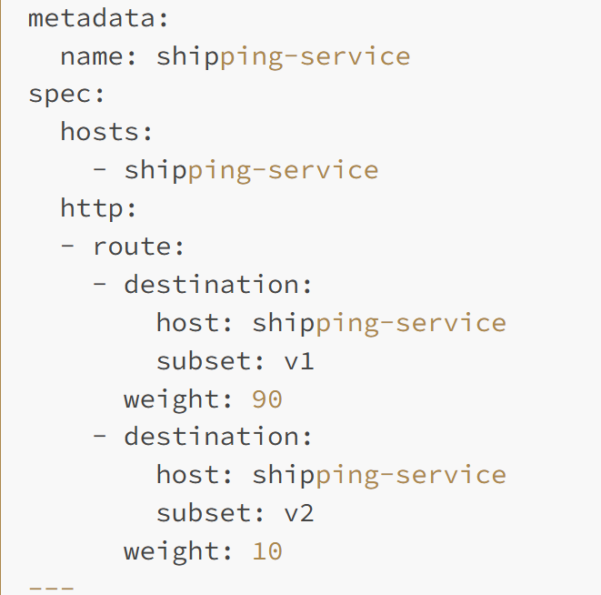
Istio Traffic Management Rules

Slide 56
What does Istio Add?
VLANs, VPNs etc are TCP/IP level abstractions for isolation. Similarly level load balancing, packet classification are mechanisms to control traffic at the IP layer using TCP ports as an (imperfect) proxy
Kubernetes (Pilot in Greek) is a great first step towards a service architecture but still low level (pods etc).
Istio (Sail in Greek) forms a network of services so it’s a true service level networl
Reuses old network ideas (traffic classification rules, load balancing, control data separation) at the service level

Slide 57
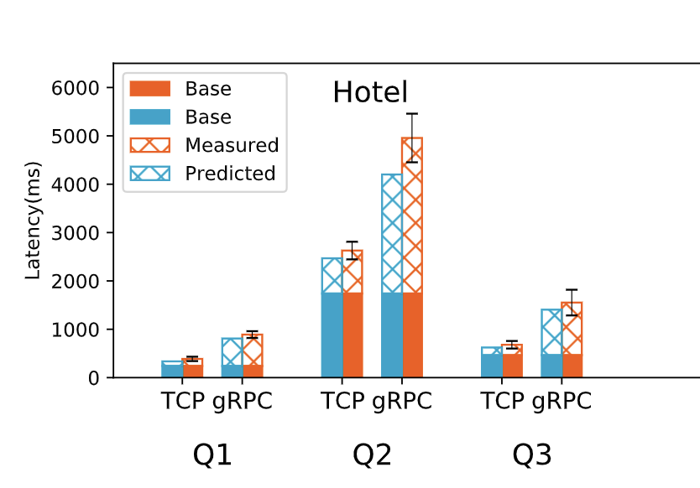
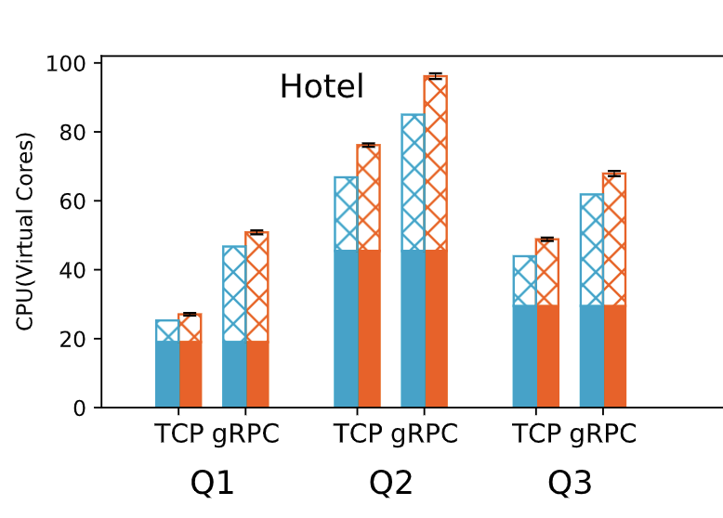
Service mesh overhead measurements

Slide 58
Conclusions
Virtualization is a big idea In computer science. Not surprising to see it in the form of VLANS, VPNs at the IP level
Lots of mechanisms we reuse: IP in IP encapsulation, packet classification, added headers, software defined networks
In last few years making progress towards service level networks with Istio but same ideas (e.g., rules) at a higher level of abstraction.
Ultimately, just adding another layer of indirection (the virtual layer) as in most of CS

